Slide 1
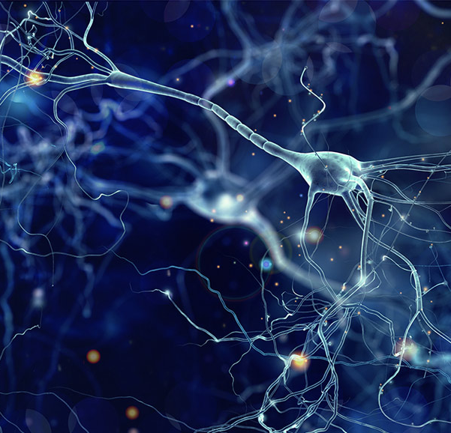



Neuromorphic Control of Embodied Central pattern generators
A Bio-Inspired Approach to Motion
By Christian Fernandez Lorden
Under the supervision of Prof. Pierre Sacré and Prof. Guillaume Drion
University of Liège
School of Engineering and Computer Sciences
Academic year 2022-2023

Slide 2
Content
Introduction
Definition of Neuromorphic Concepts
Problem Statement
Exploration of the Neuron Model
Controller Design
Definition of feedbacks type
Simple one and two motor neurons controllers
Neuromodulated controller
Network of controllers
Results
Simulations of all controllers
Maps of behavior of simple controllers
Stability analysis of neuromodulated model
Conclusion
Summary of results
Limitations of the controller
Suggestion for future works

Slide 3
Introduction

Slide 4
Start
The control of locomotion in robotics is difficult
No controller with the level of robustness and adaptability of biological system
Neuromorphic aims to extract useful properties of biological system
Investigate neuromorphic control of a simple mechanical system

Slide 5
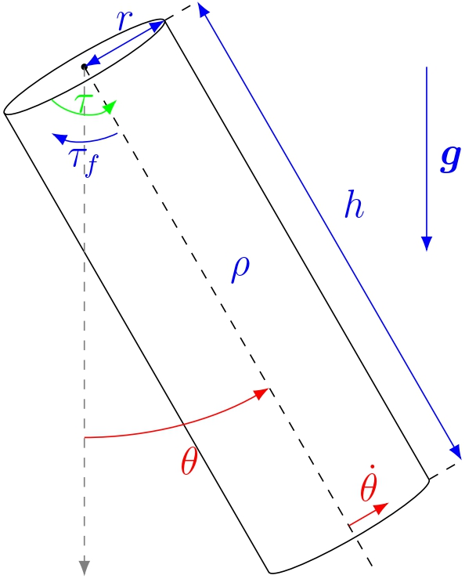
Problem Statement
Design a robust controller for pendulum swing
Neuromorphic
Act on torque
Use angular position and velocity
Symmetric oscillations
Control at a desired amplitude
Follow natural frequency of system

Slide 6
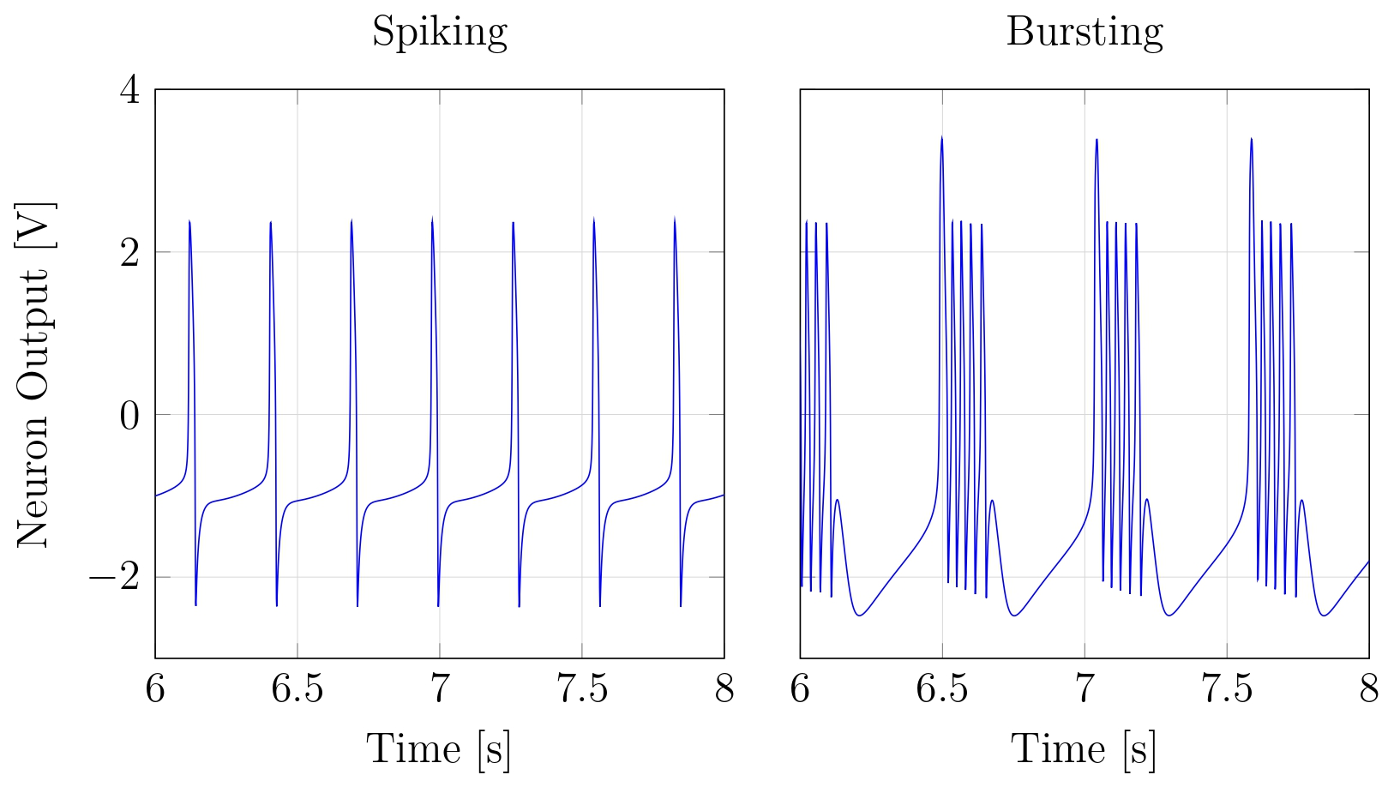
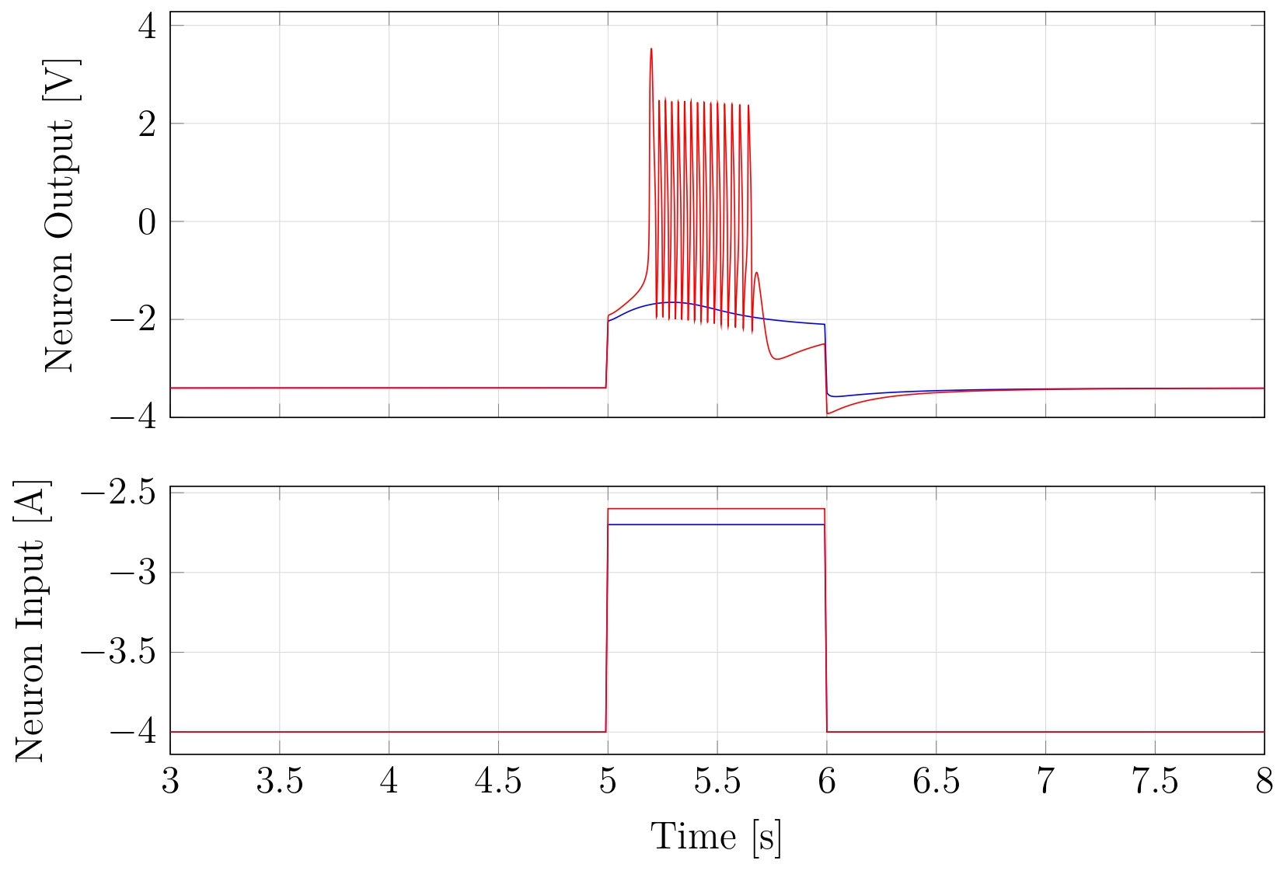
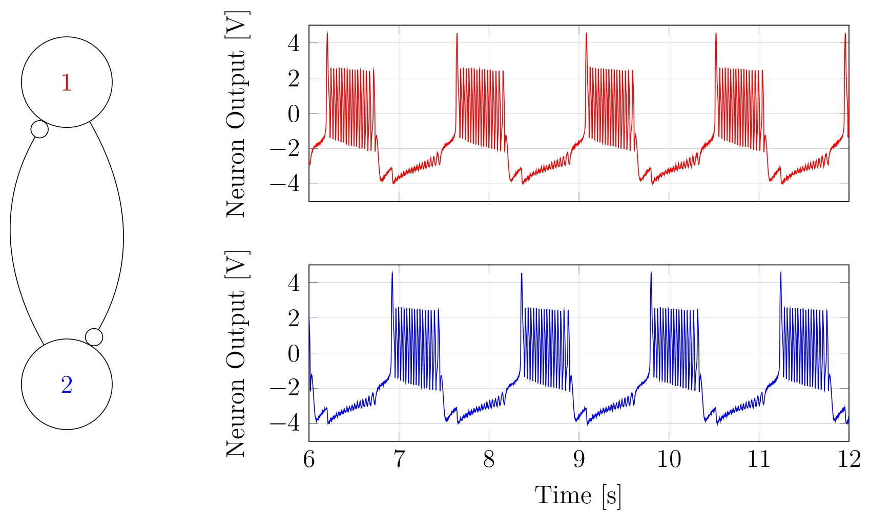
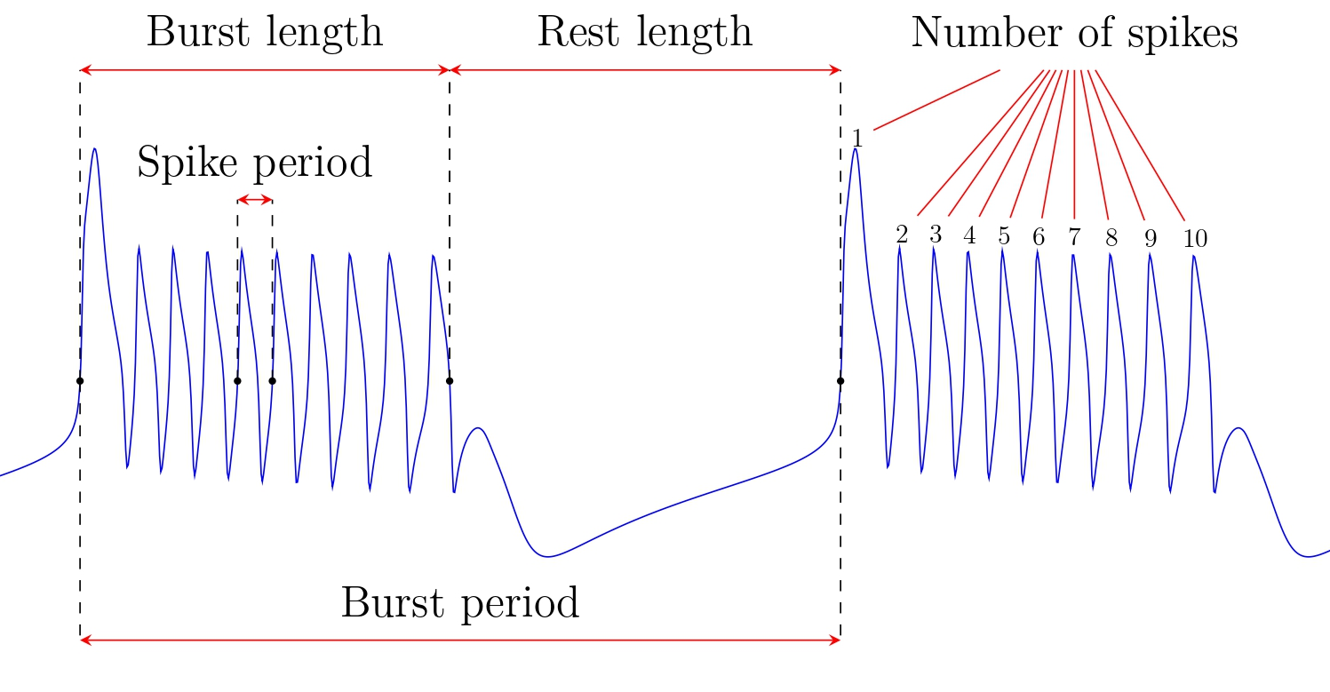
Neuromorphic Concepts
Excitability
Neuronal Behaviors
Central Pattern Generators

Slide 7
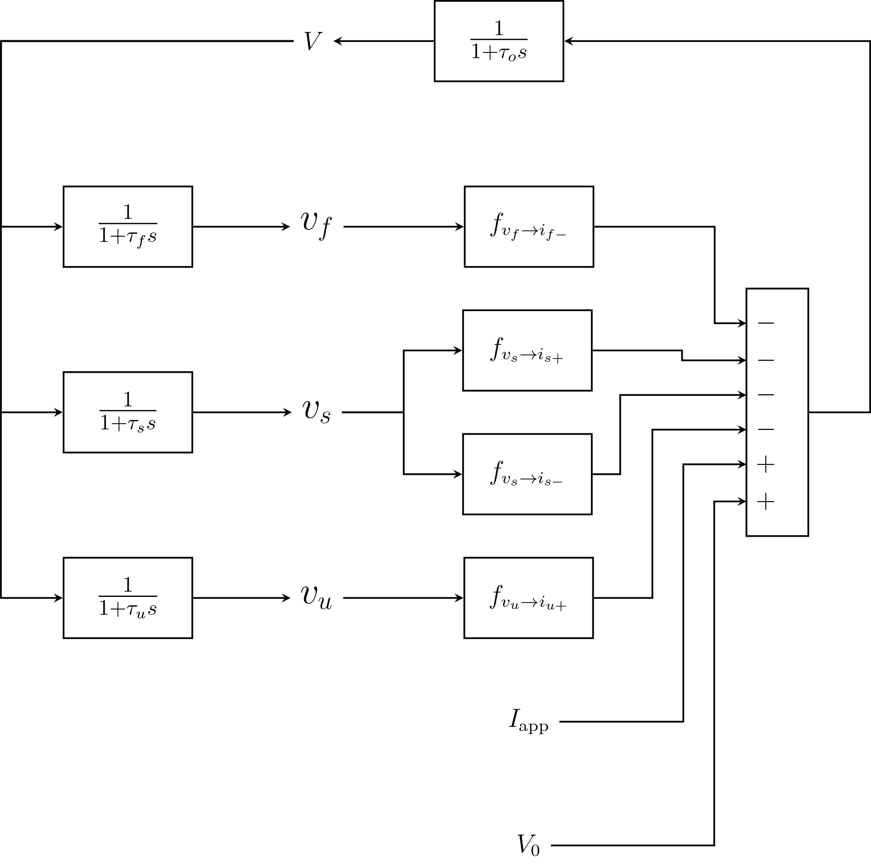
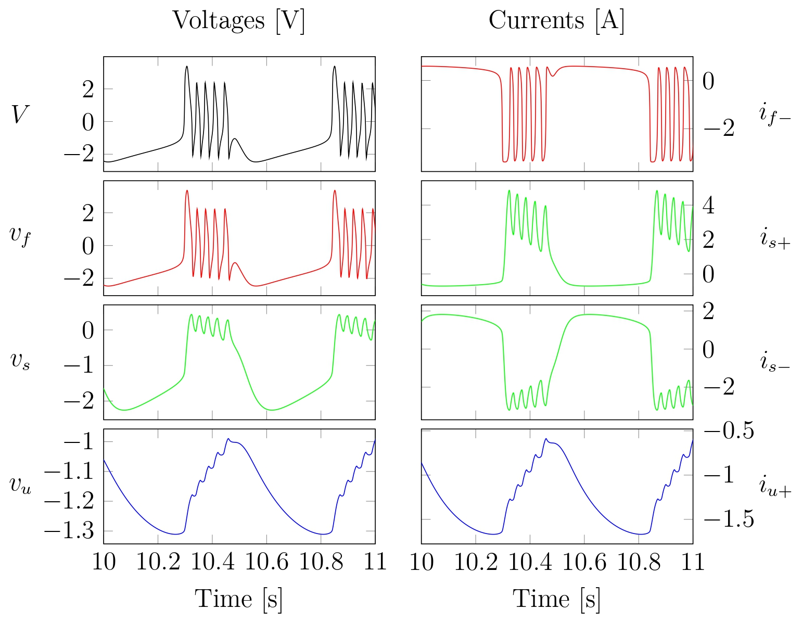
Neuron Model

Slide 8
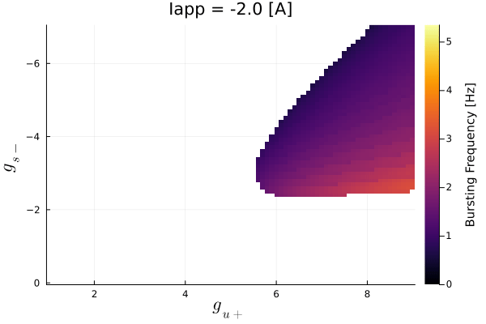
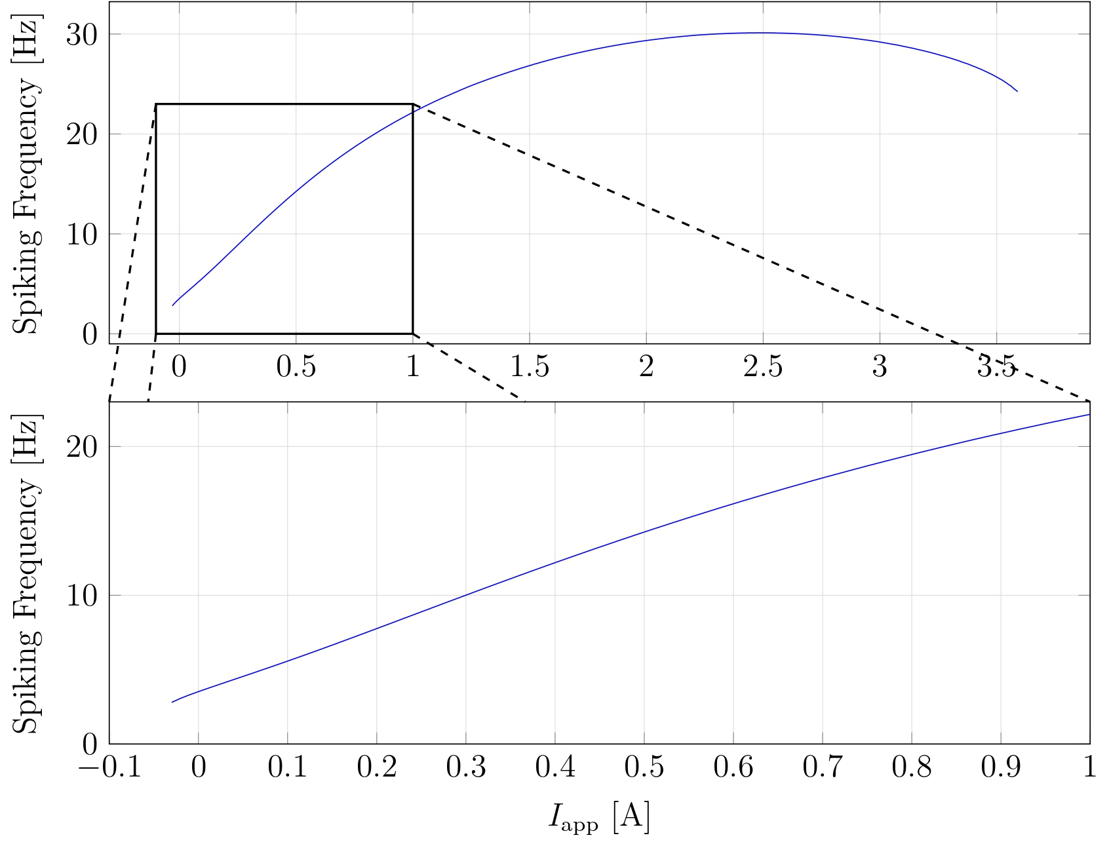
Neurons Properties
Bursting Neuron
Spiking Neuron

Slide 9
Controller Design

Slide 10
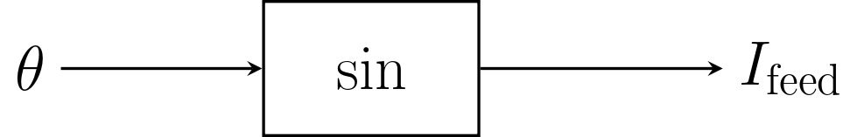
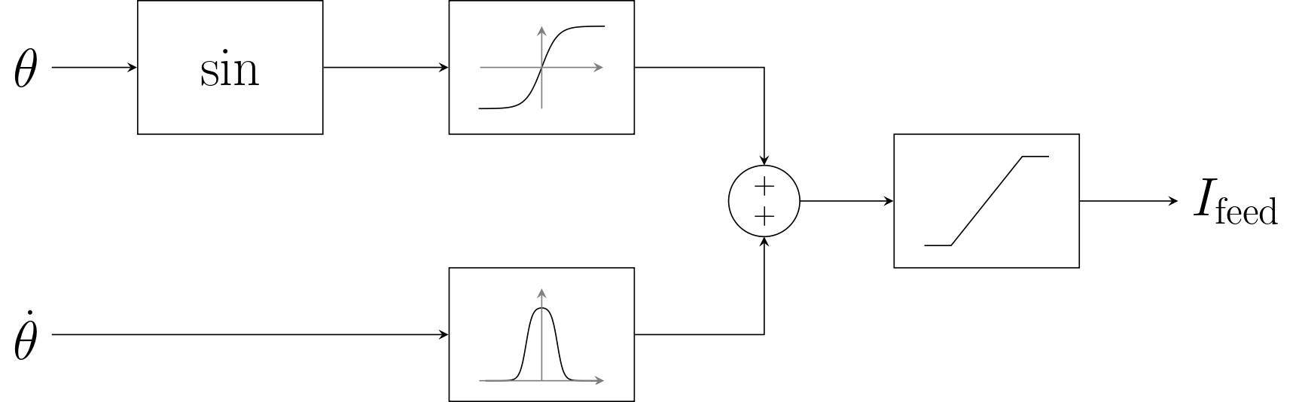
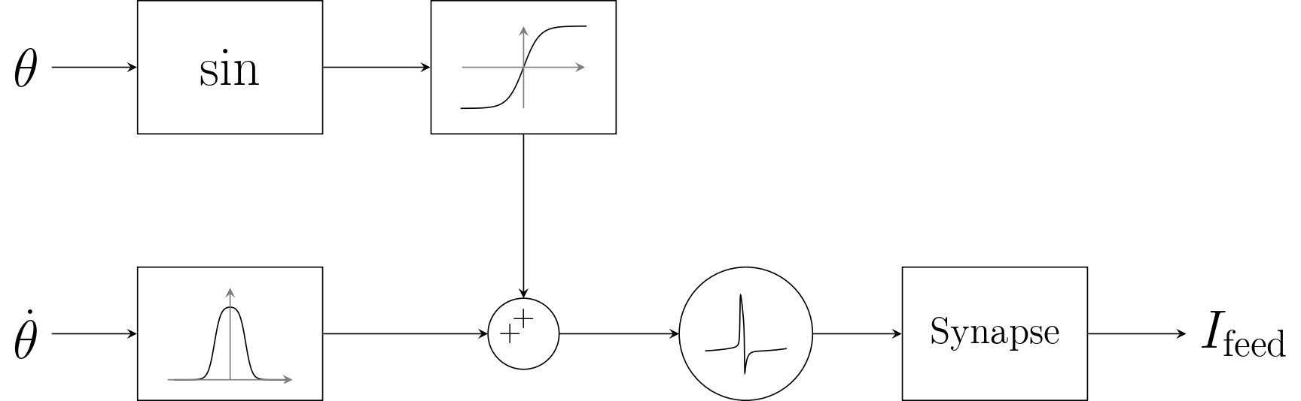
Feedbacks from Mechanical System
Direct Feedback
Mixed Feedback
Spike Feedback

Slide 11
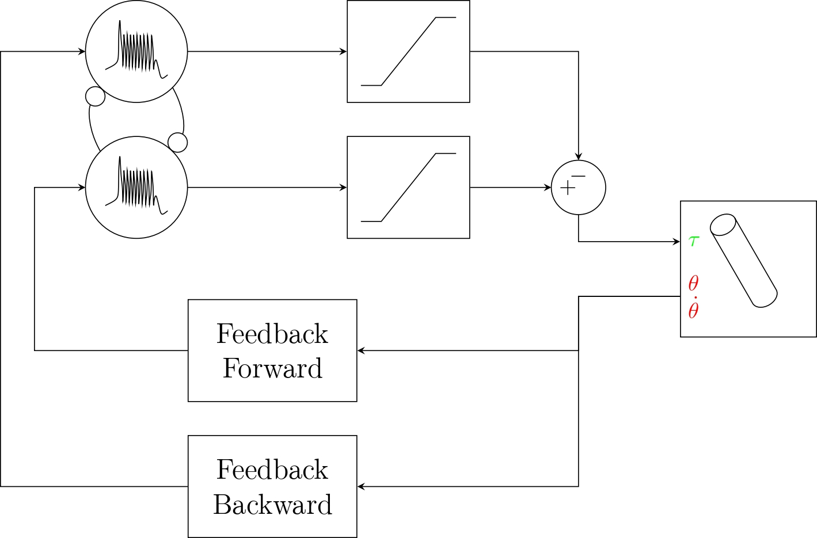
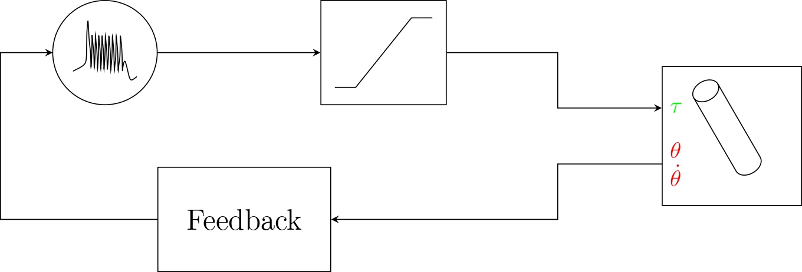
Simple controllers
One motor neuron
Two motor neurons

Slide 12
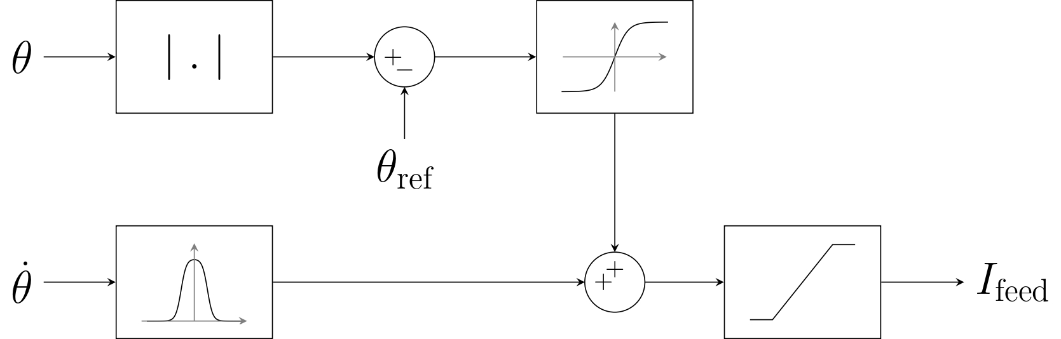
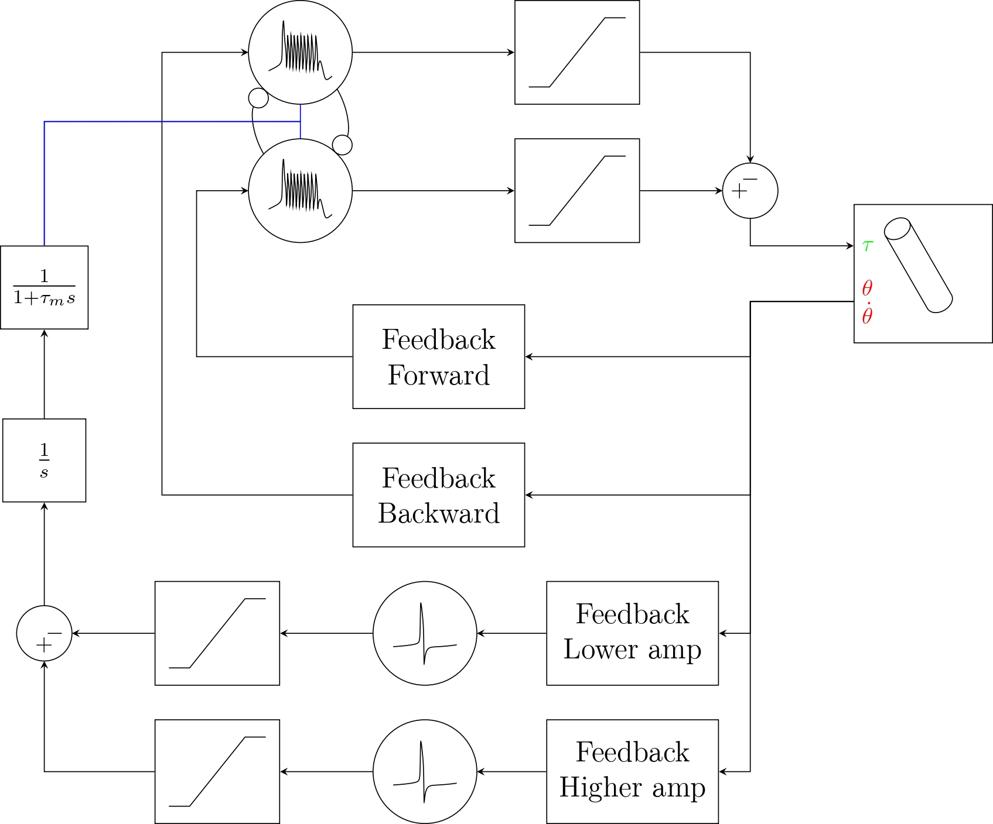
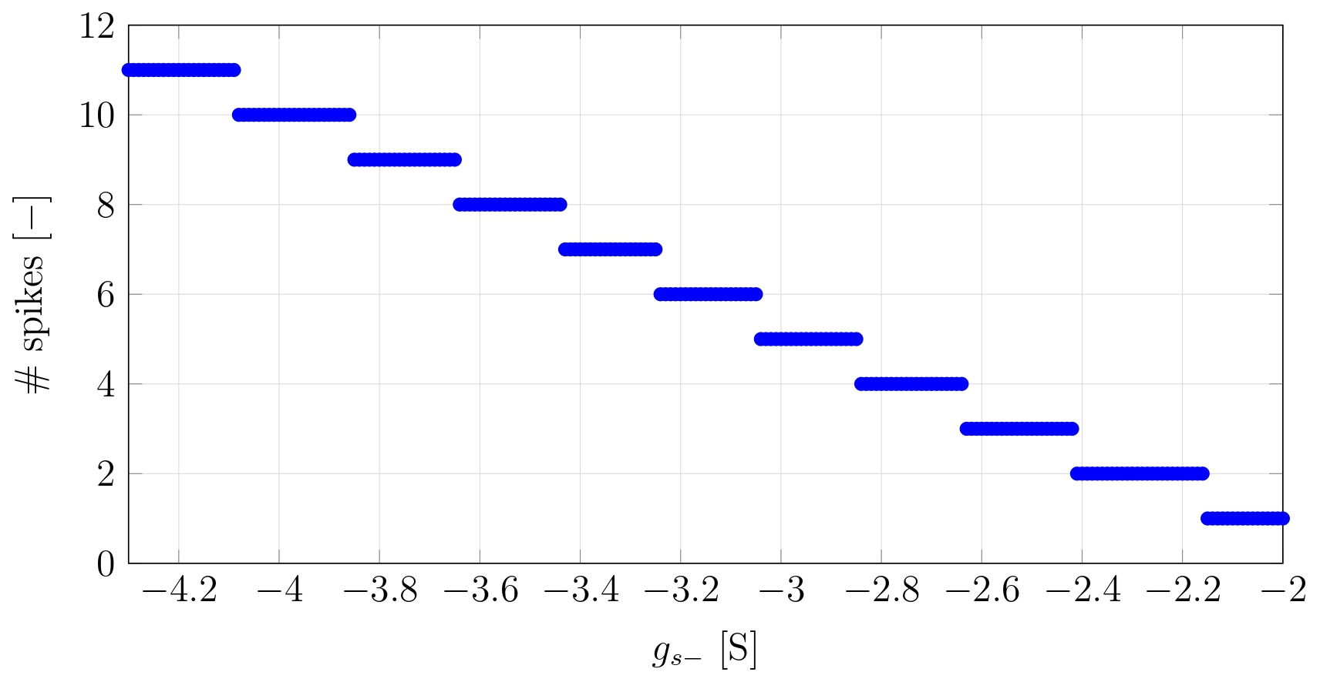
Neuromodulated Controller

Slide 13
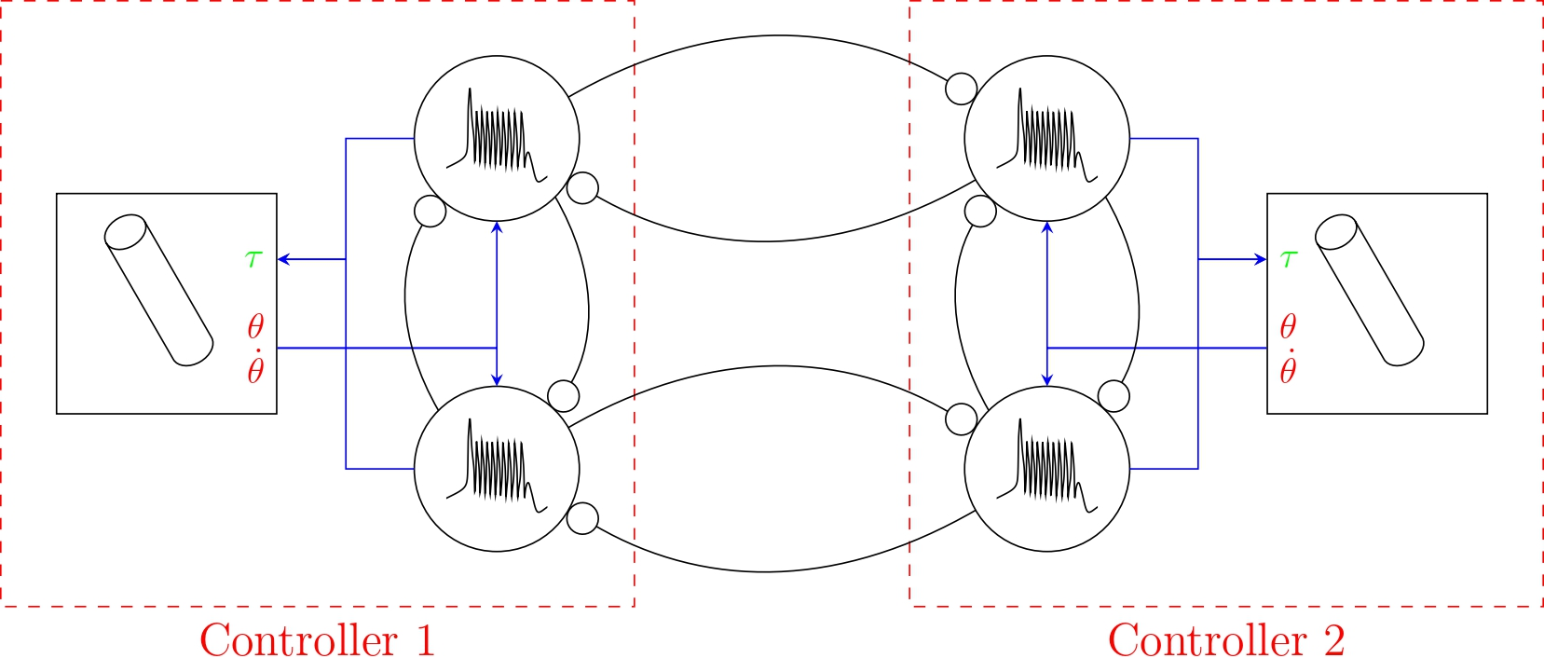
Interconnection of Controllers
Goal : Achieve phase opposition between pendulums
Reduced CPG synapses strength to accommodate new synapses

Slide 14
Results

Slide 15
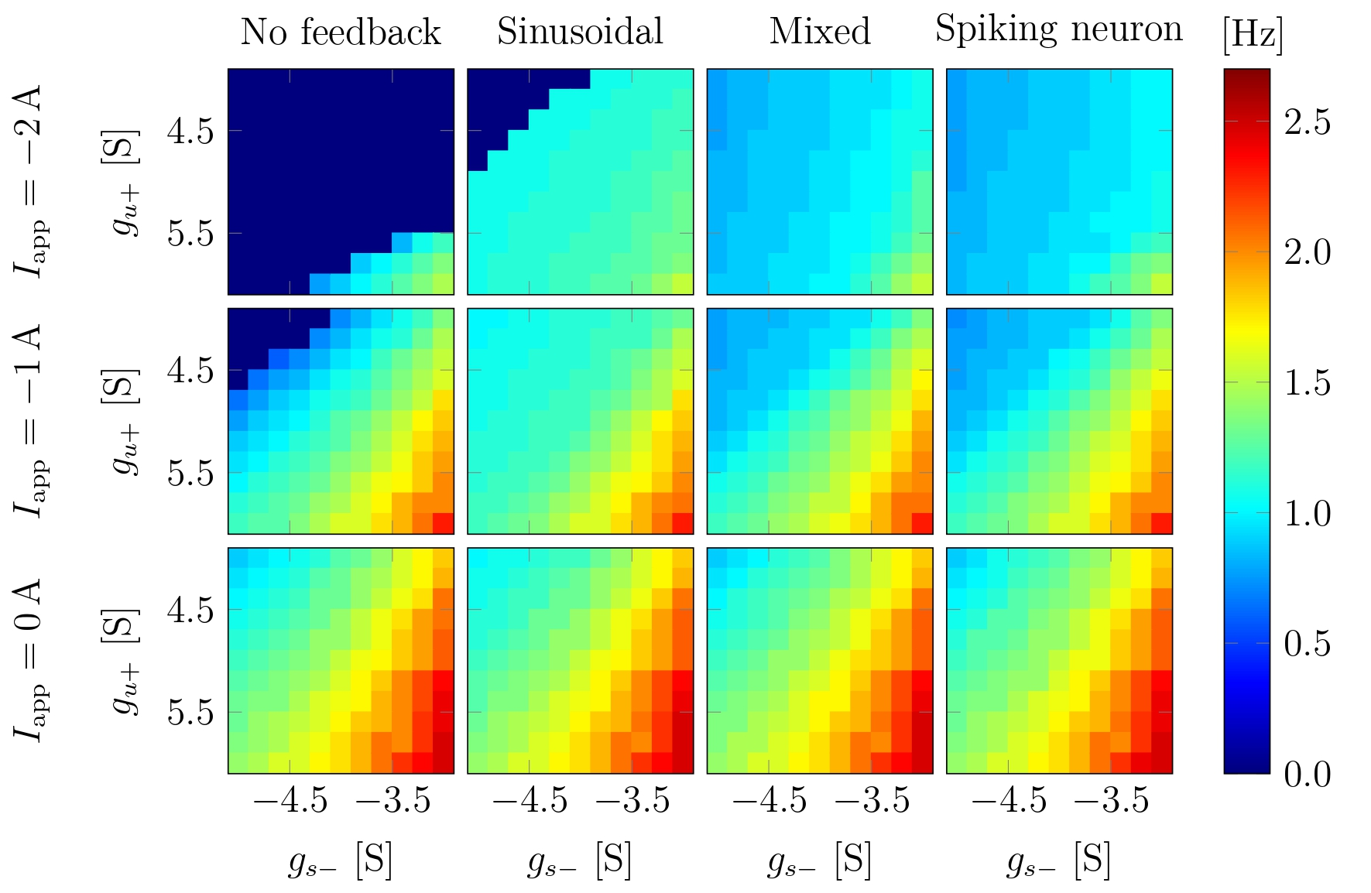
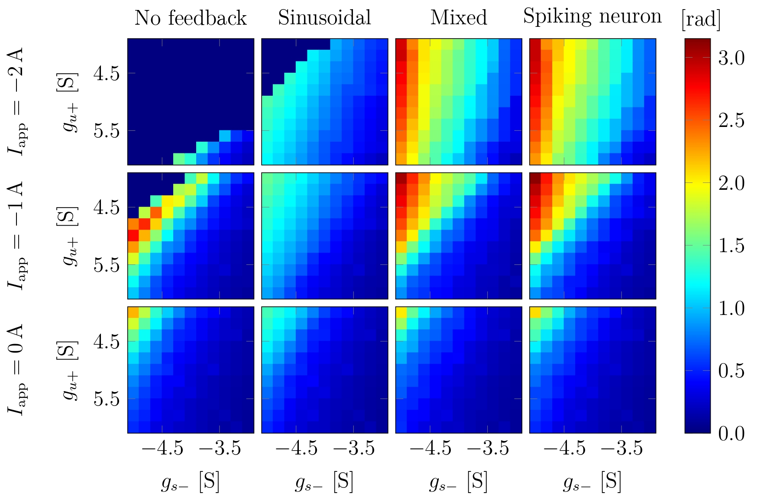
One-Neuron Controller Performances

Slide 16
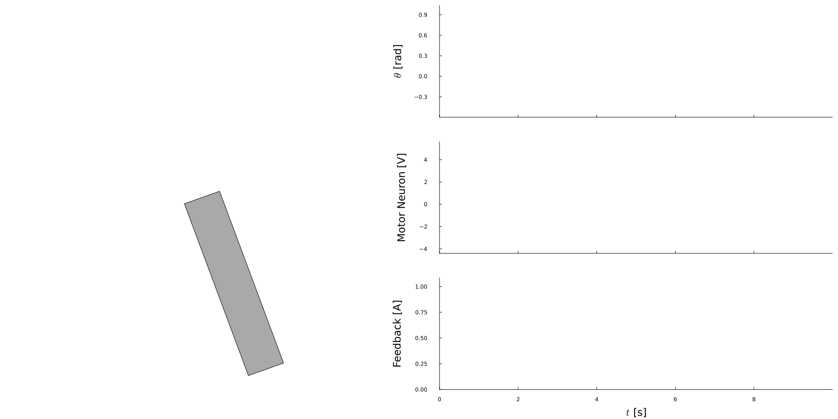
One-Neuron Realisation

Slide 17


Comparison of “event” feedbacks
<- Mixed Feedback
Spike Feedback ->

Slide 18
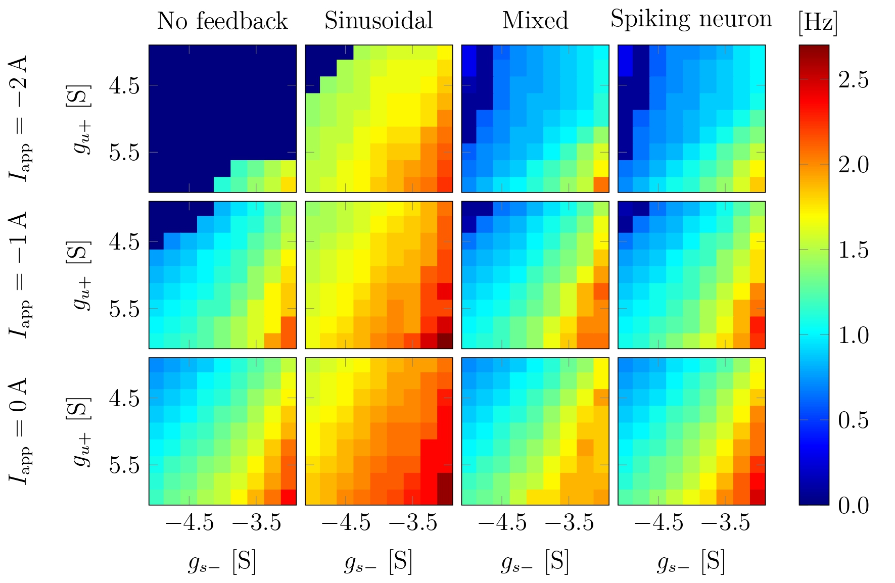
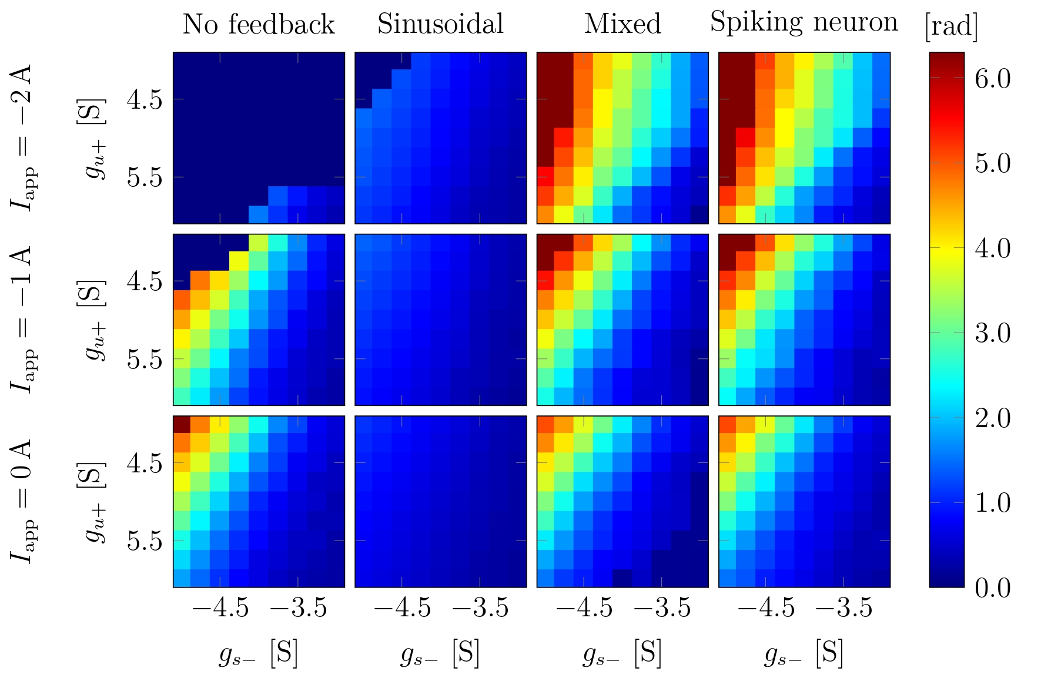
Two-Neurons Controller Performances

Slide 19
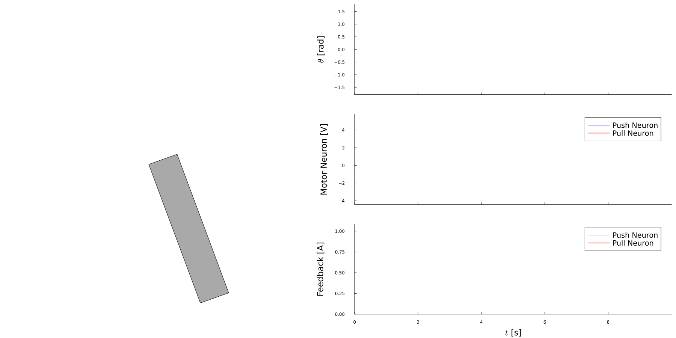
Two-Neurons Controller

Slide 20
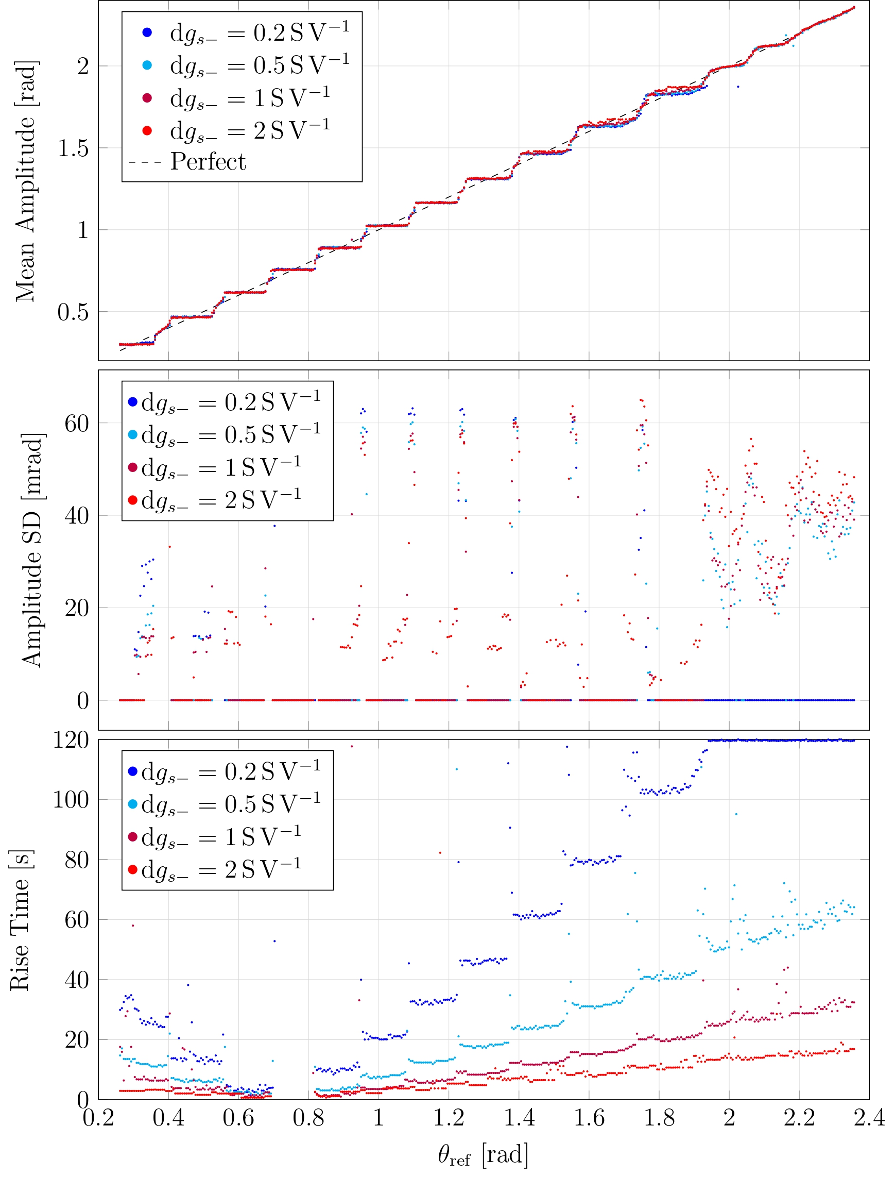
Neuromodulation Performances
Step-like behavior
Follow target in mean
Small interval of non-stability

Slide 21
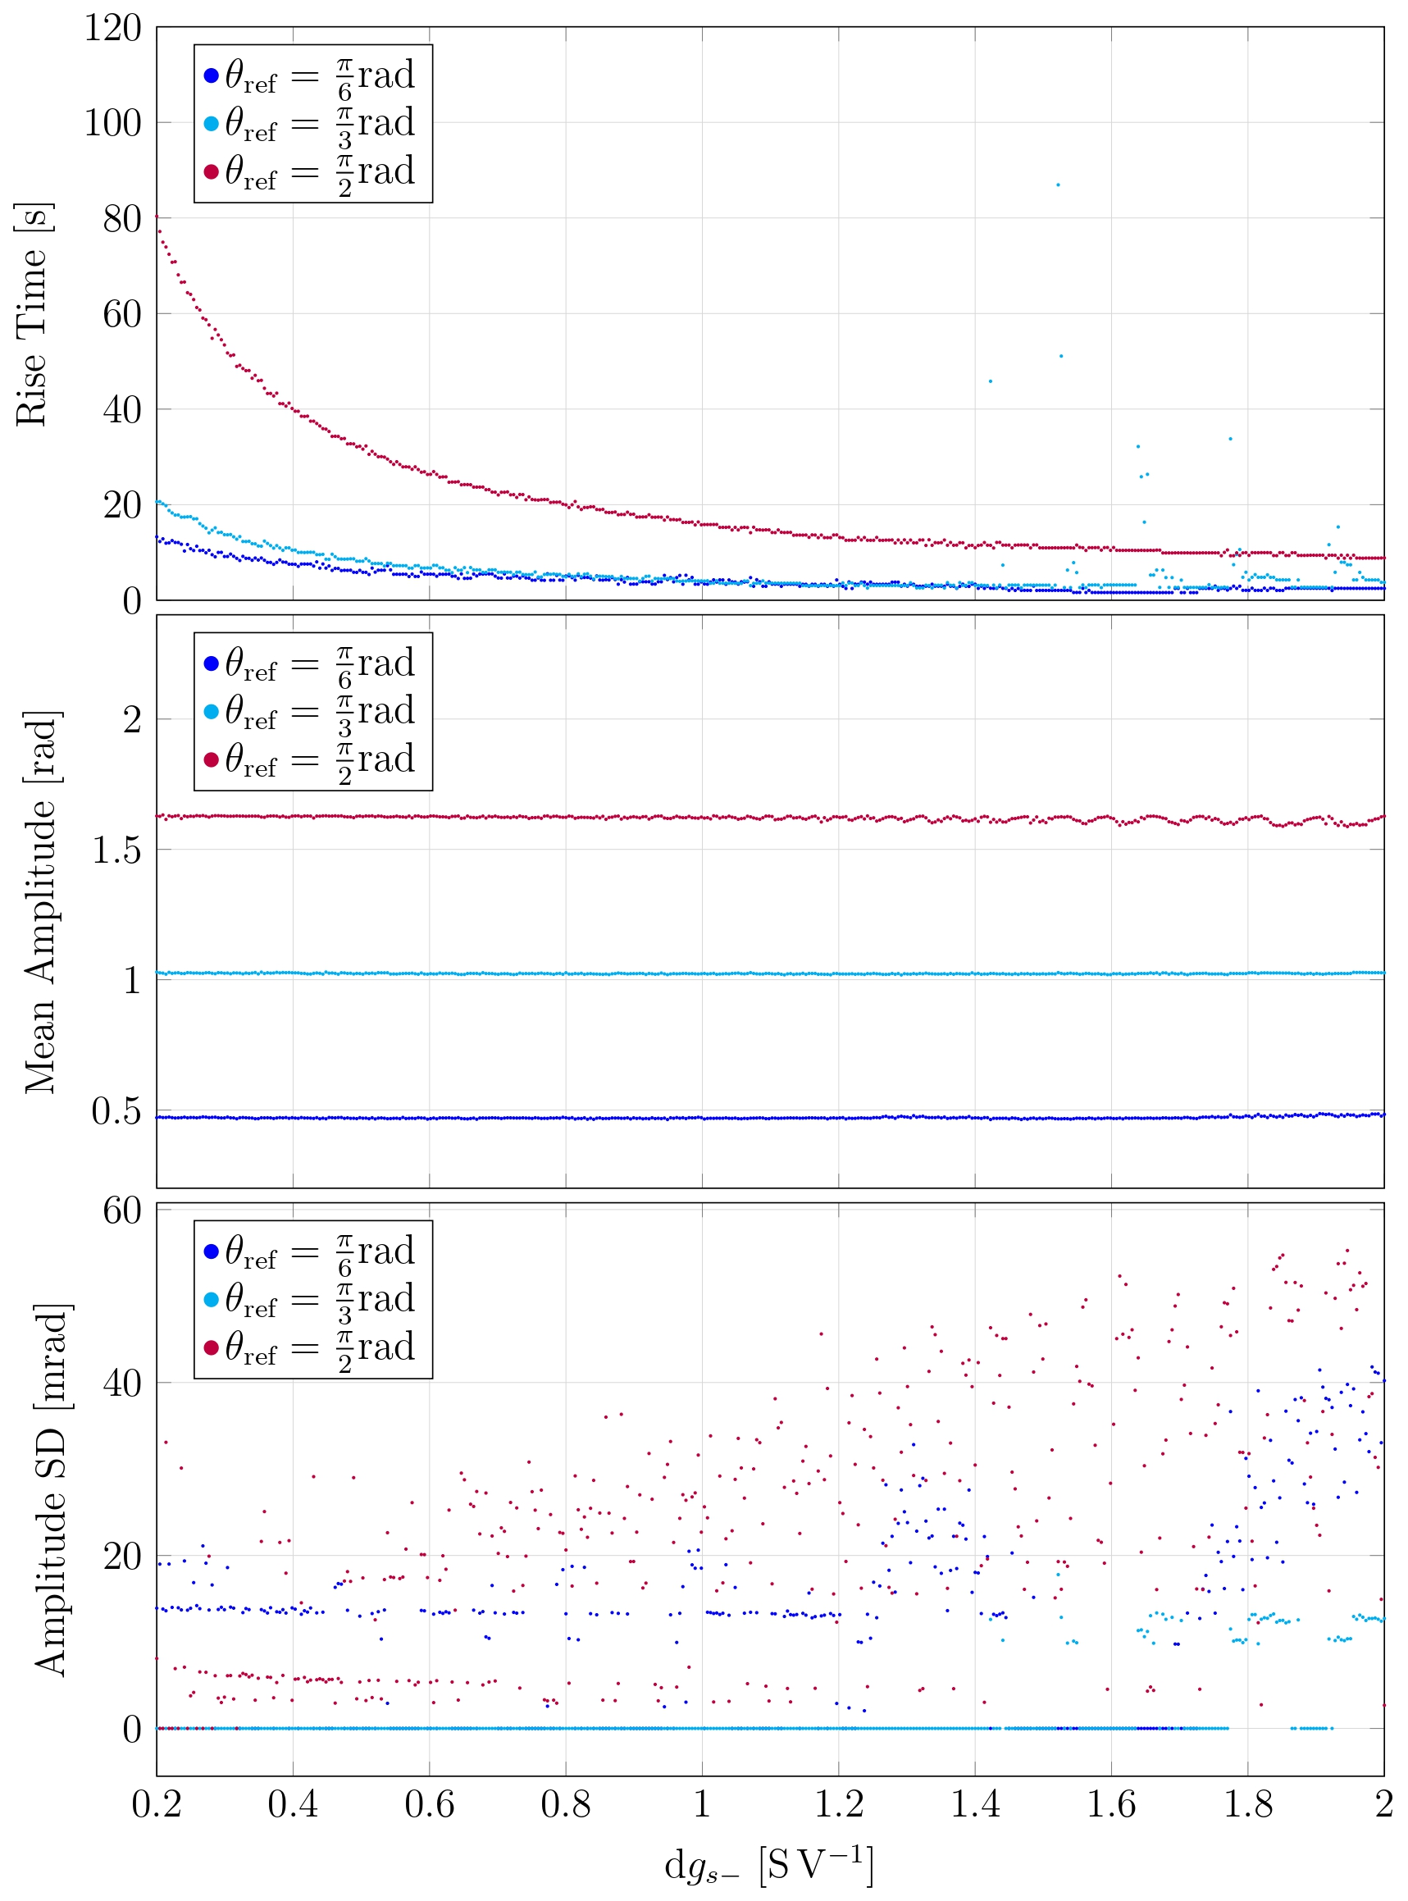
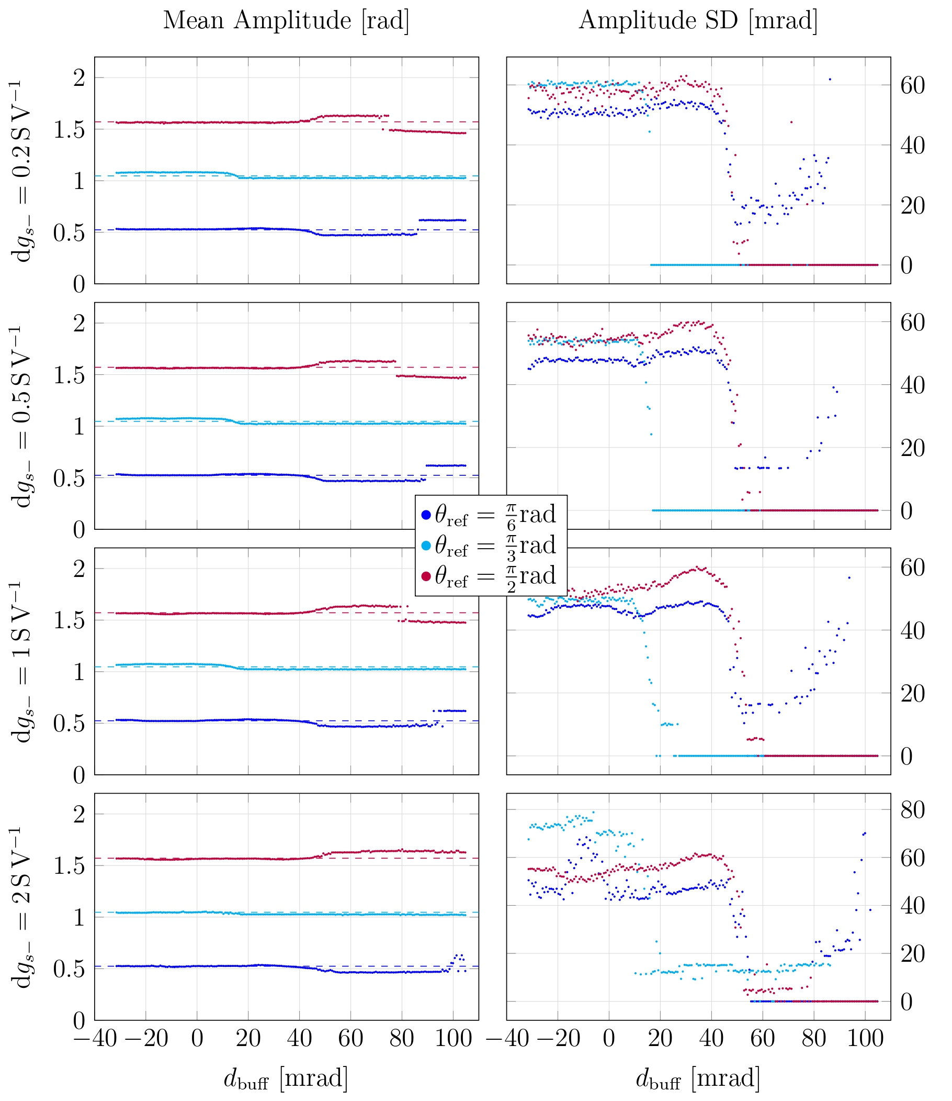
Neuromodulation Performances

Slide 22
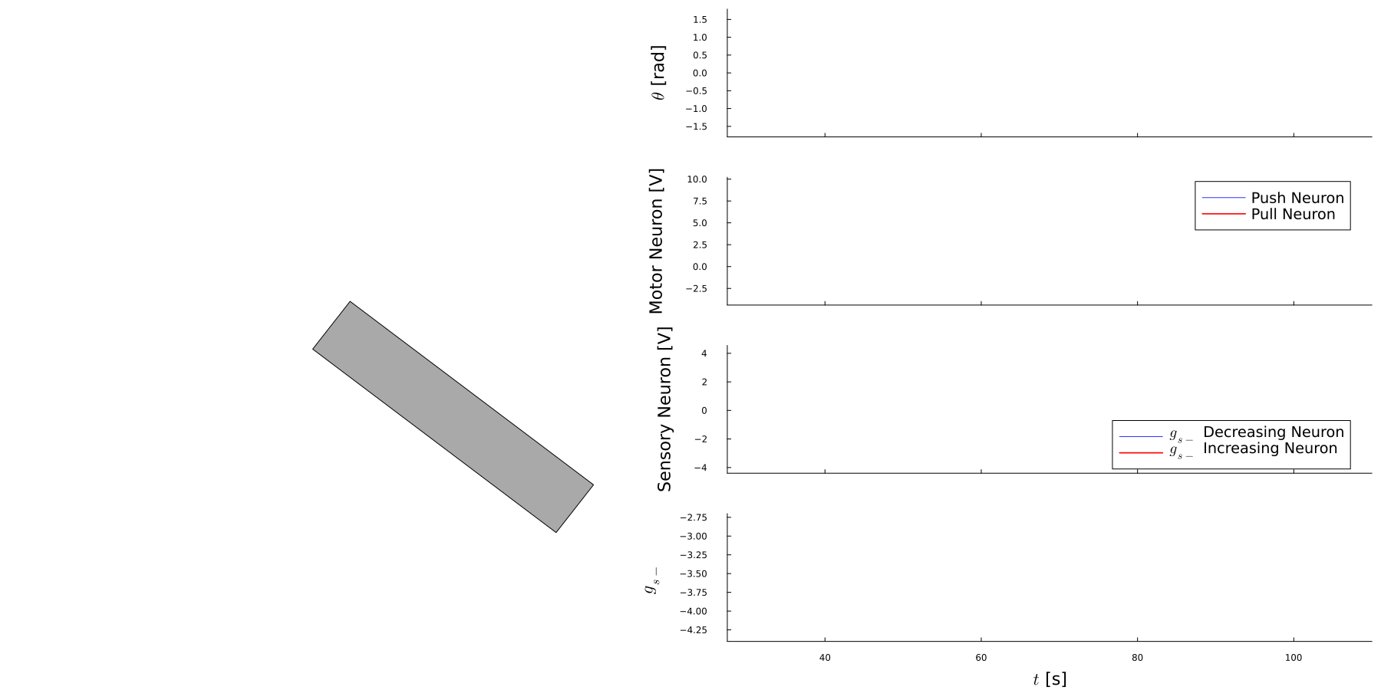
Neuromodulation realisation

Slide 23
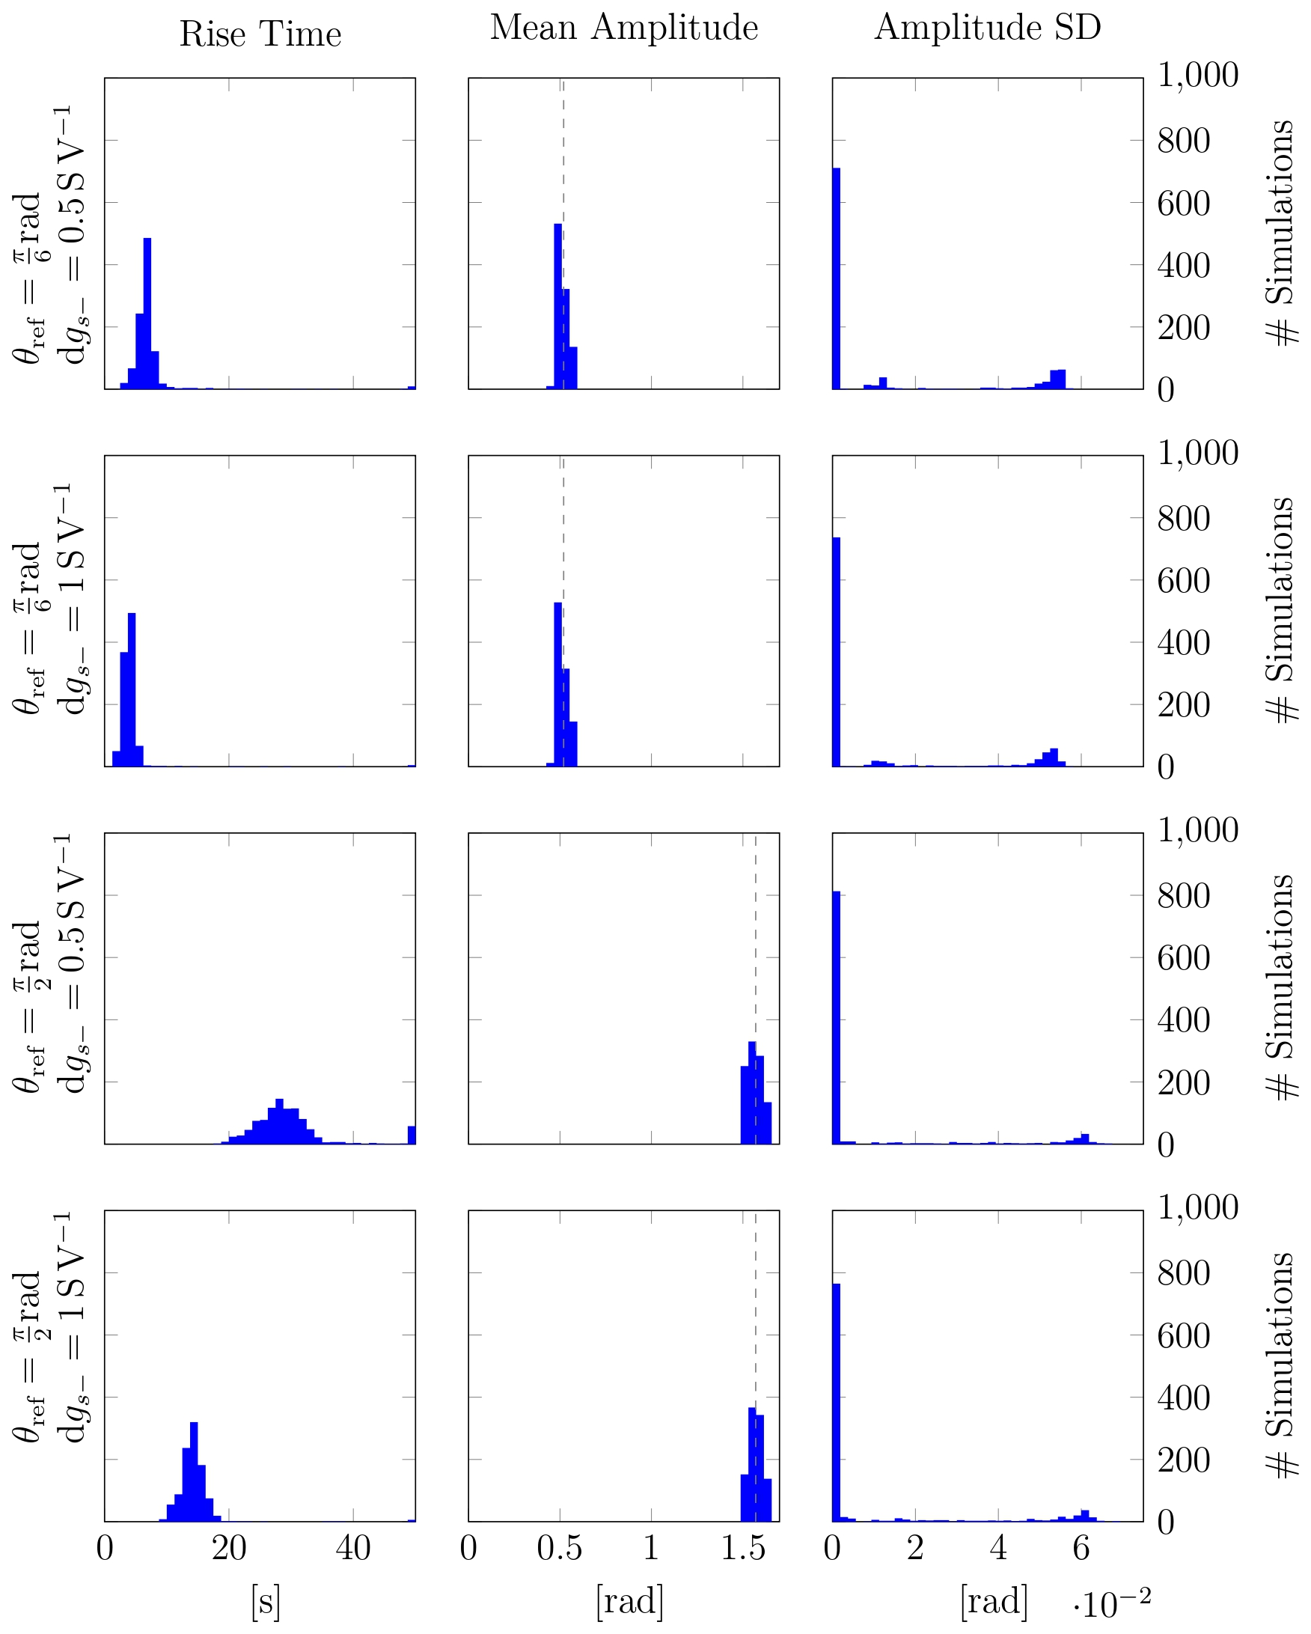
Neuromodulation Stability
Angle distribution tight and centred around desired angle
75% of simulations reach stable amplitude
Rise time distributions varies logically with change in neuromorphic gain

Slide 24
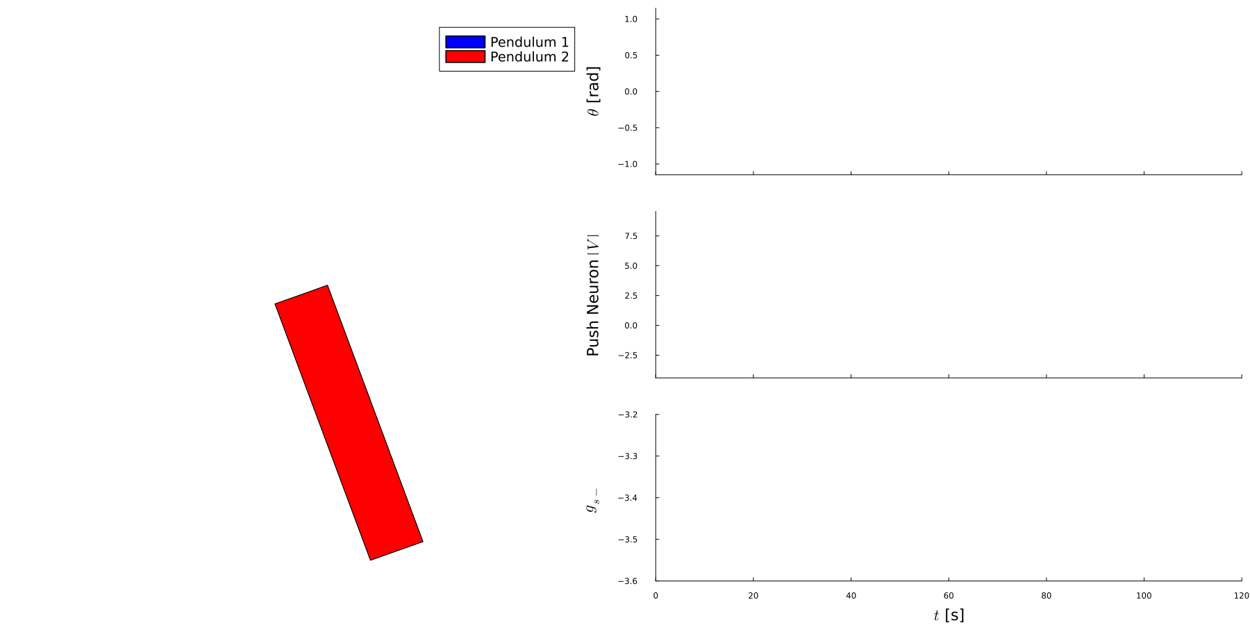
Network Realisation

Slide 25
Conclusion

Slide 26
Results Summary
Design reaches goal and tracks desired angle
Precision of tracking limited by discrete level of energy
Trade-off between speed of convergence and stability
Design easily connected in a network

Slide 27
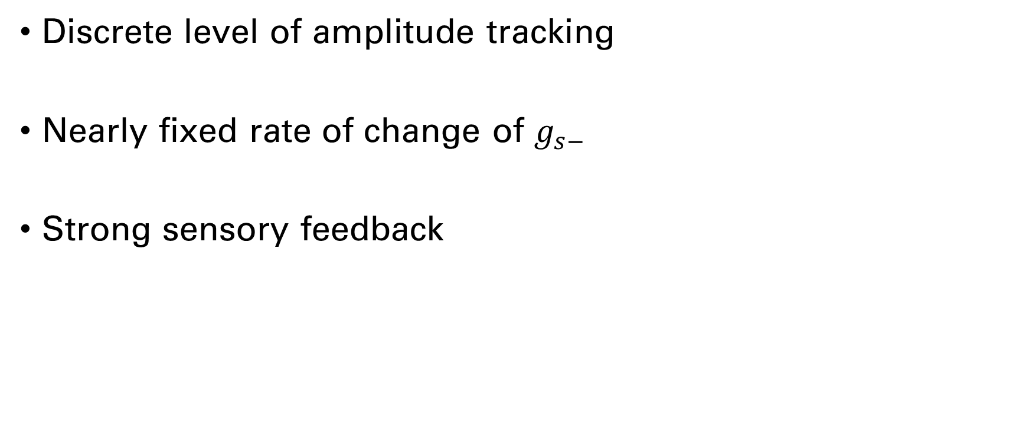
Limitations
Discrete level of amplitude tracking
Nearly fixed rate of change of $g_{s−}$
Strong sensory feedback

Slide 28
Future Works
Study performance difference with other control schemes
Neuromodulation on spike characteristic of burst to reach more precise amplitude control
Further study interconnection of multiple controller systems
Use weak sensory feedback in combination with CPG frequency adaptation

Slide 29
Thank You For Your attention

